Slide 1


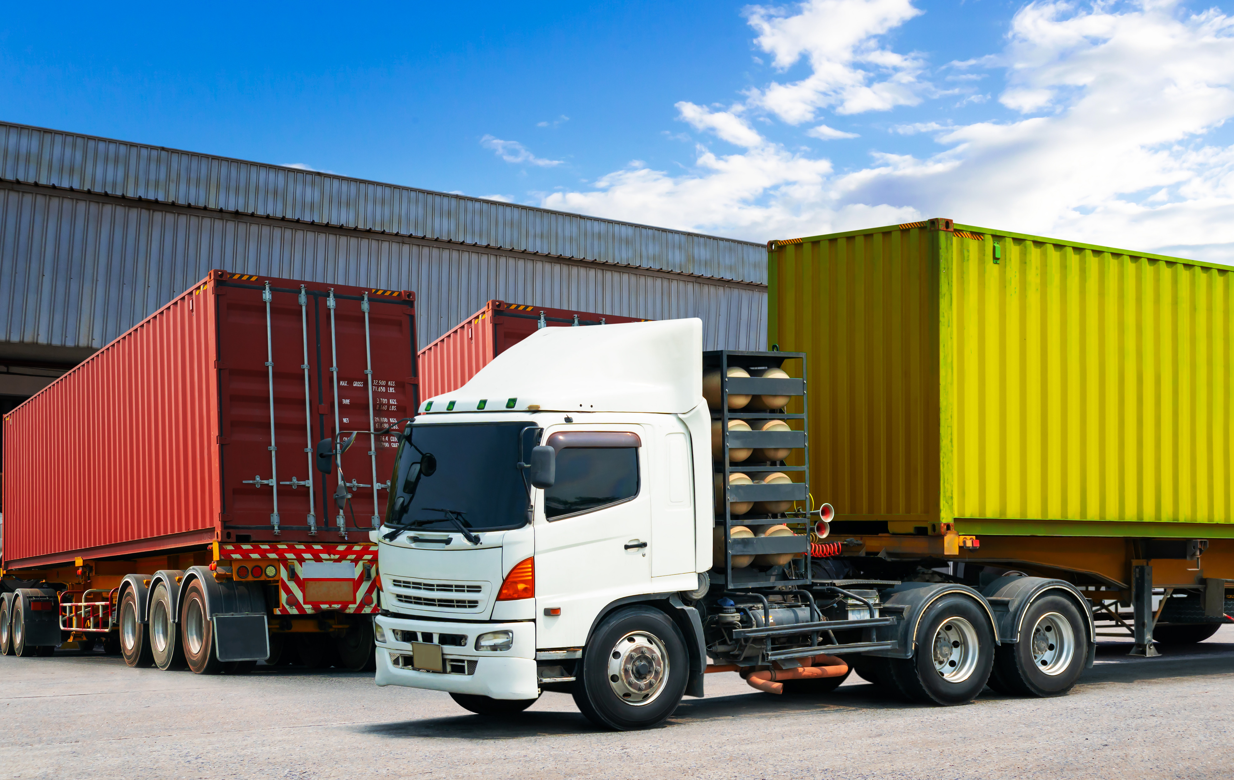
AGENTIC AI FOR TRANSPORT MODE OPTIMIZATION
Bhargav Rishi Medisetti
Deep Learning | Prof. Reza Ebrahimi | Muma College of Business

Slide 2
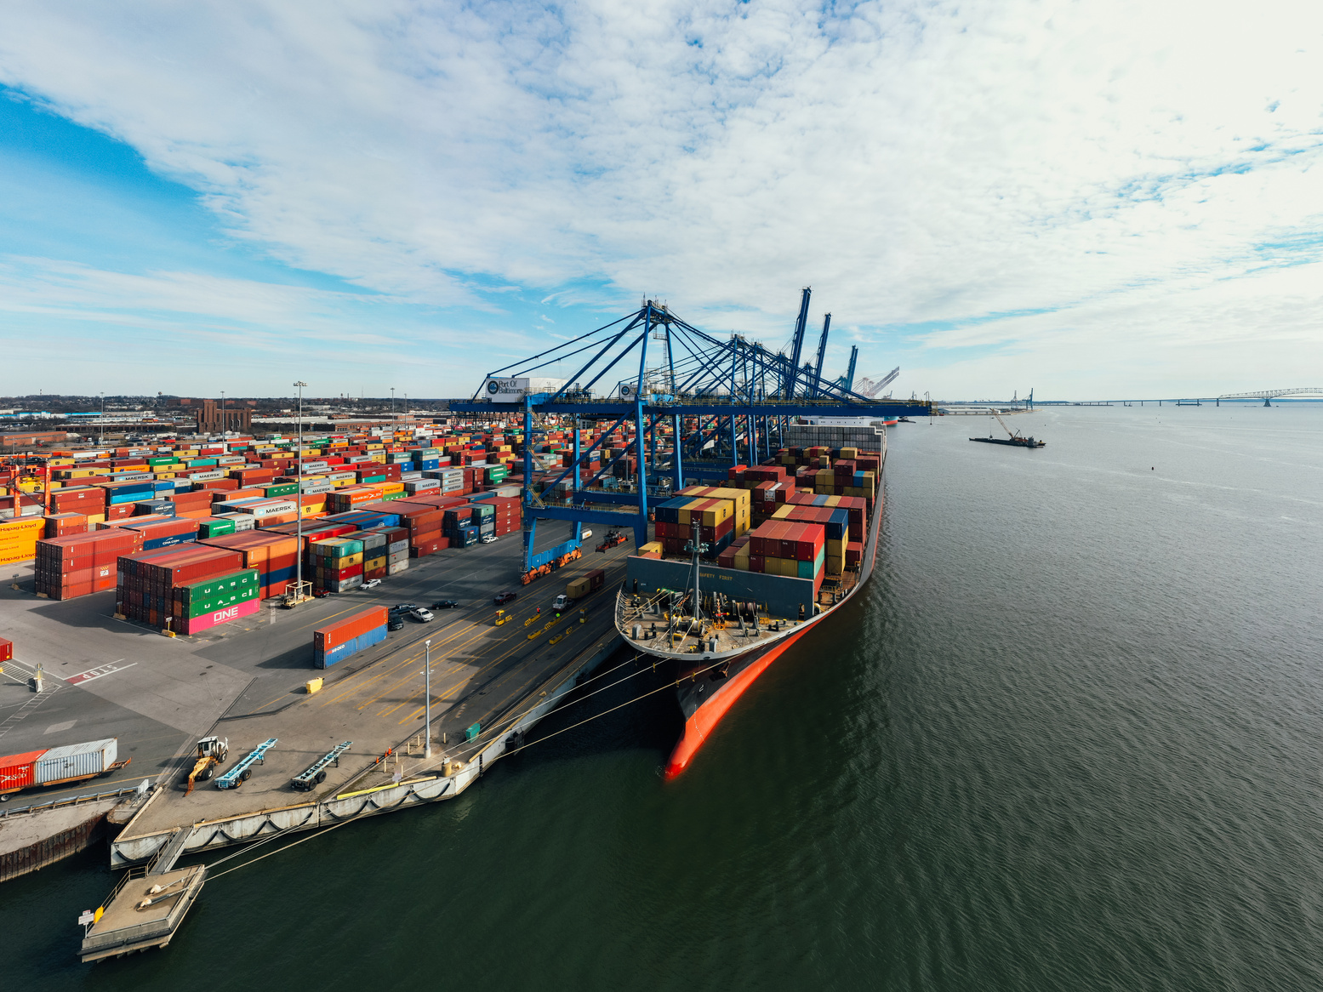
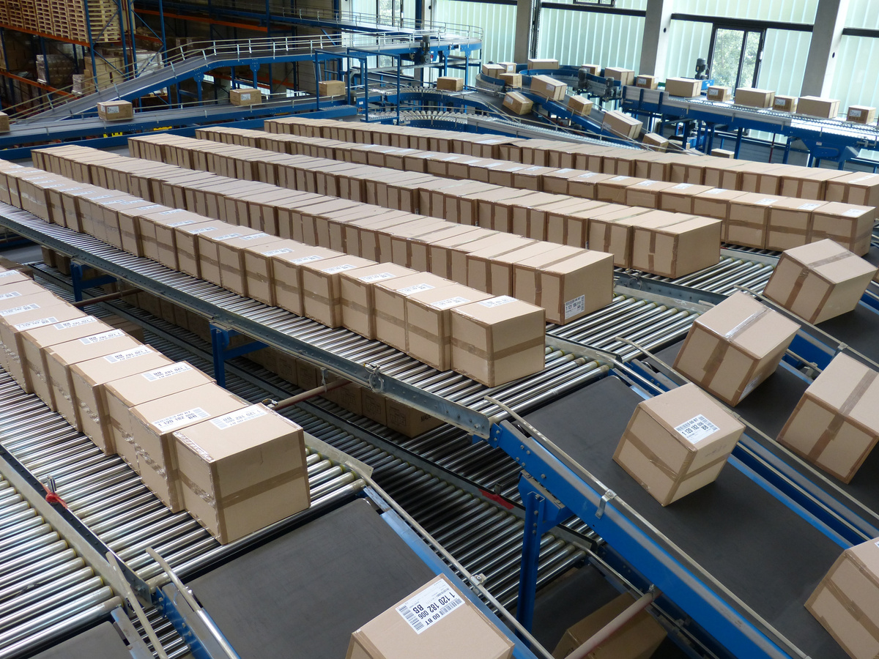
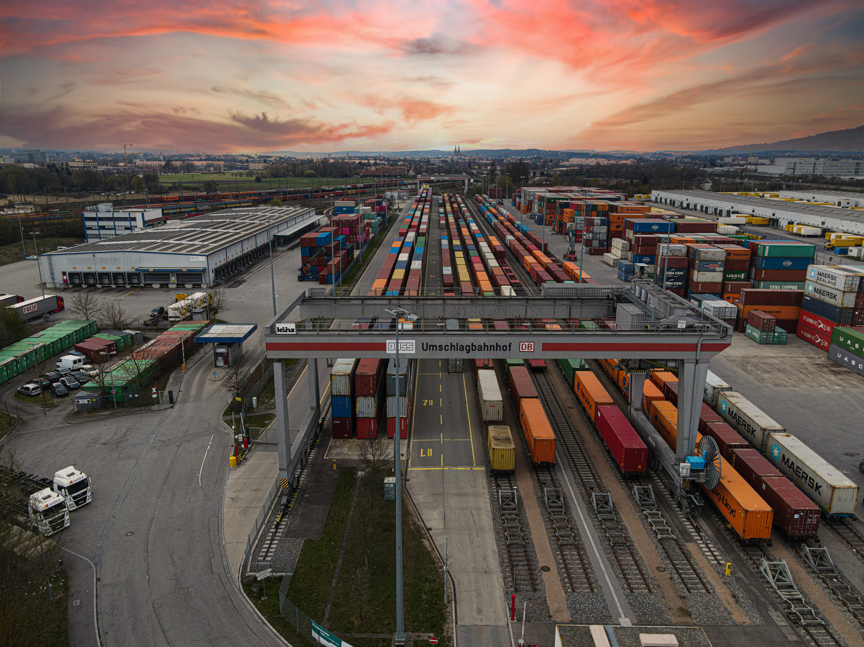
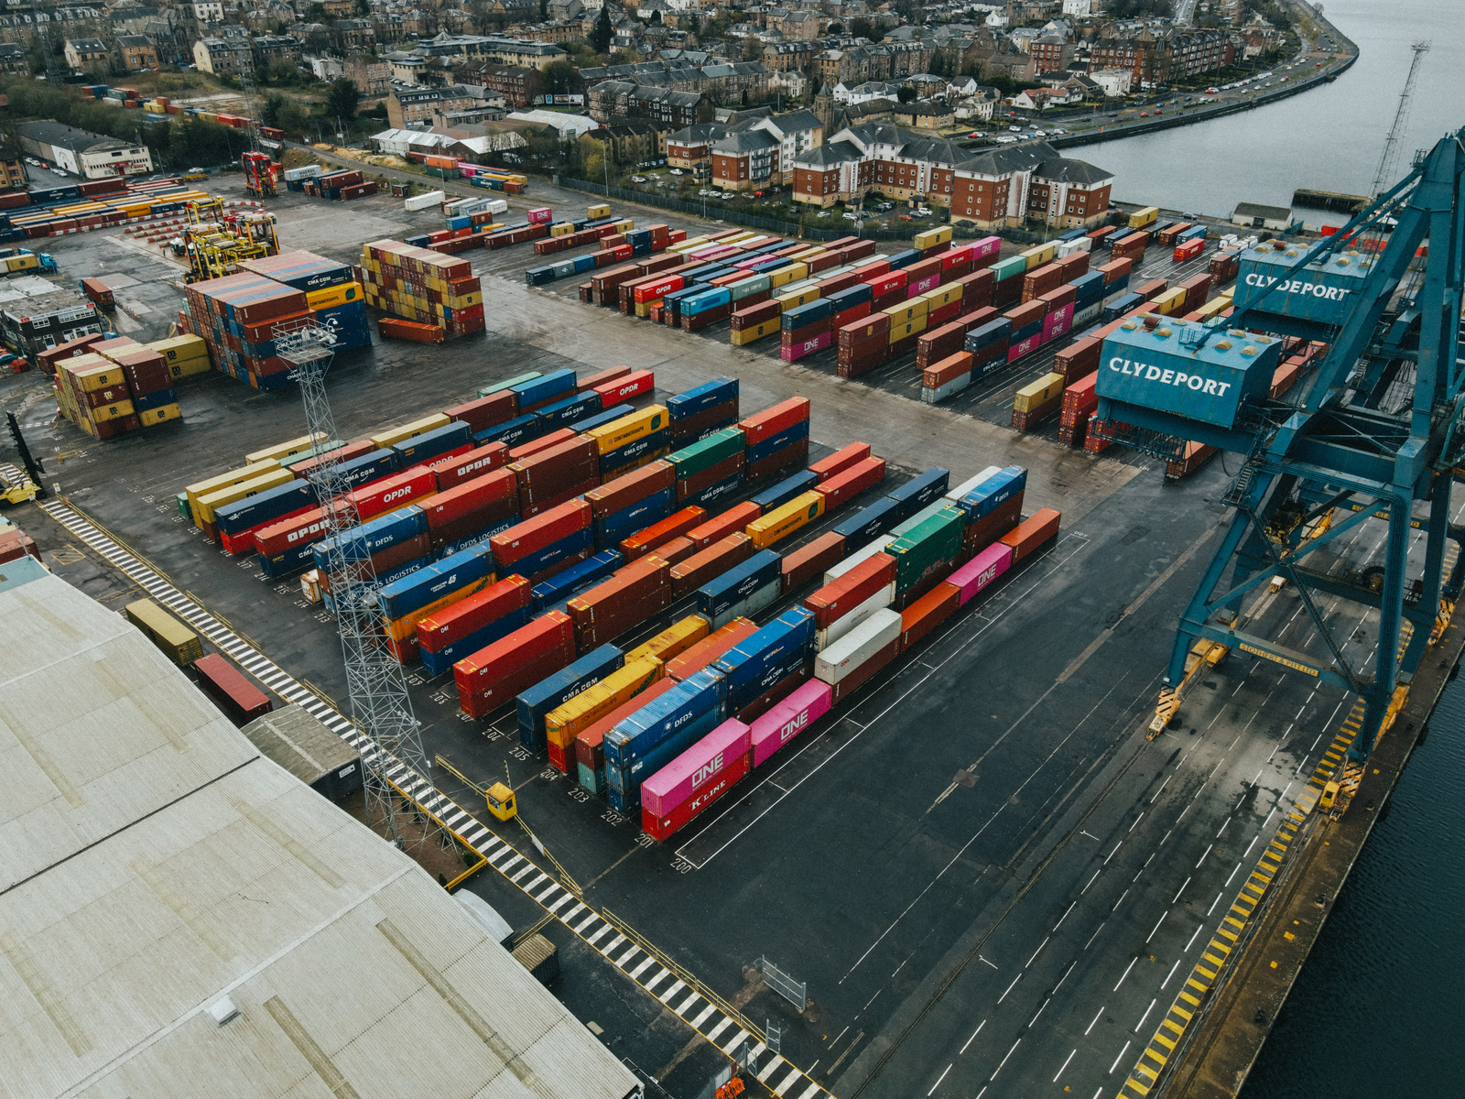
MISSION -
Agentic Intelligence for Smarter Freight Transport
Mission 01
Mission 02
Intelligent Decision-Making
Future-Ready Freight Planning
Mission 03
Mission 04
Agentic AI Framework
Interpretability and Value
Notes:
Use deep learning models to predict shipment costs across various transportation modes using historical and projected data.
Design an agent that can make informed transport decisions for future years (e.g., 2032, 2040, 2050), even when direct data is not available — using interpolation and forecasting.
Empower the agent to make goal-driven decisions based on cost, distance, or a balanced Deliver actionable insights with explainable analytics so logistics professionals can trust and use AI-generated decisions

Slide 3
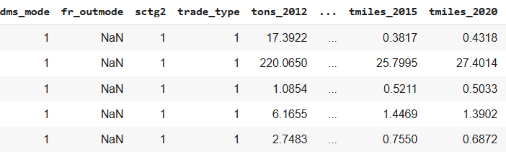
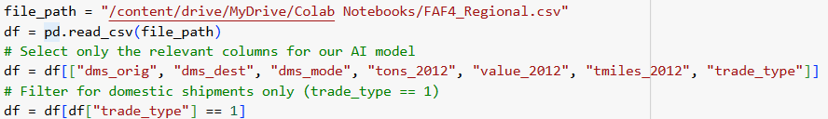
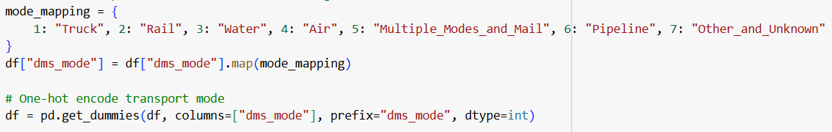
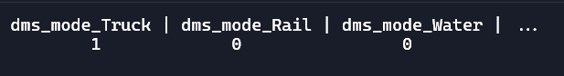
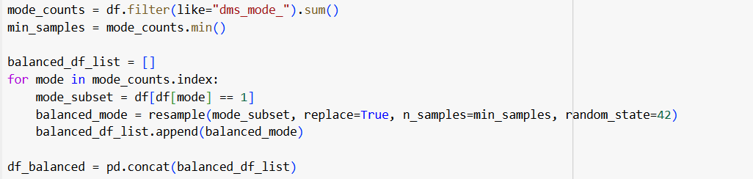
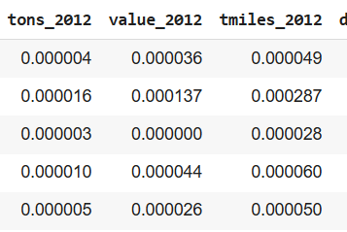
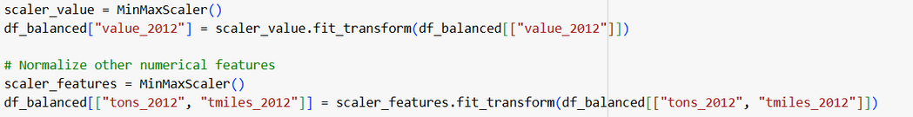
Data Preprocessing

Slide 4
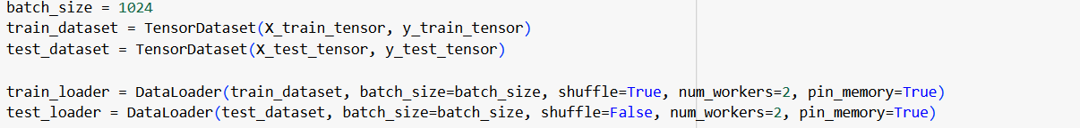
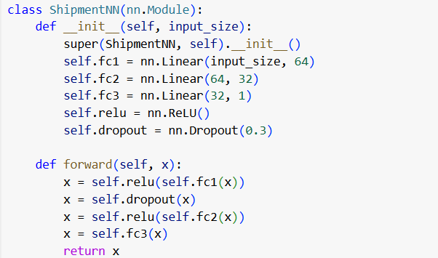
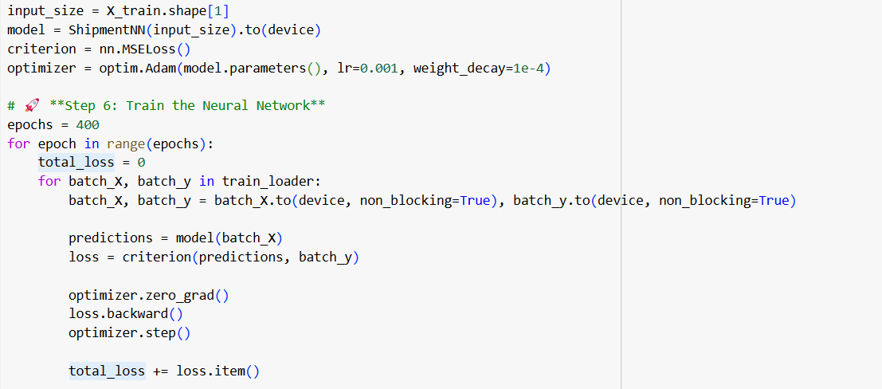
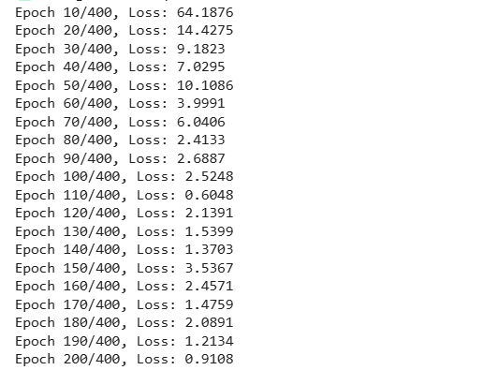
The Brains behind the AI - Feed Forward Neural Network
Input layer
Hidden layer
Output layer
Activation function
Dropout

Slide 5
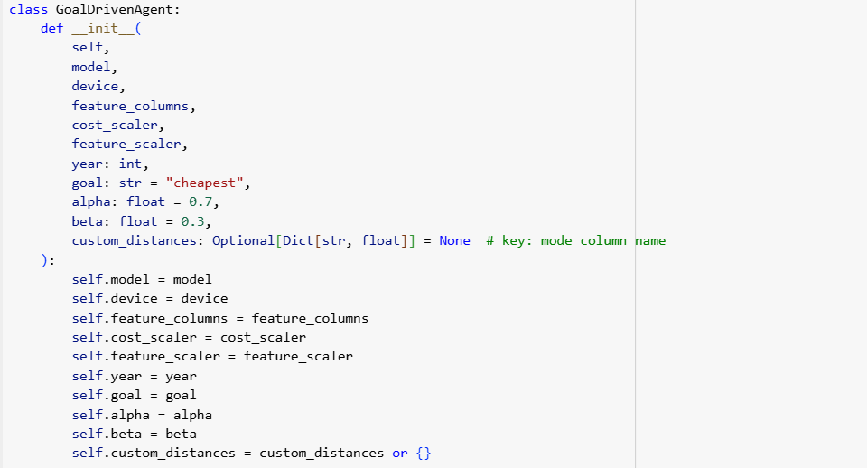
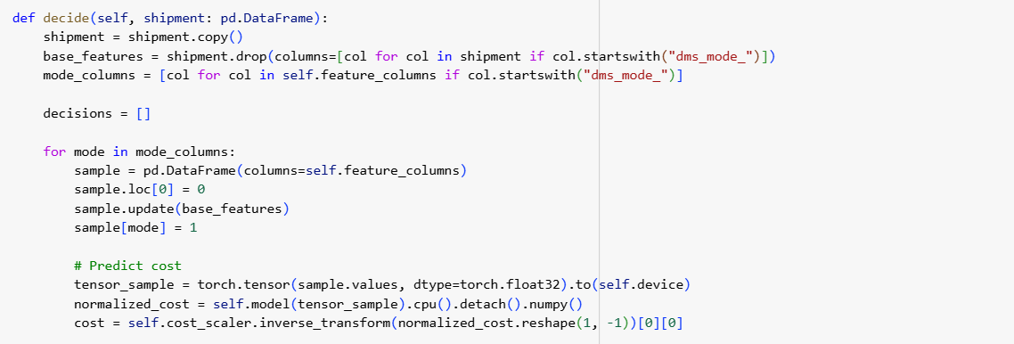
The Decision Layer – Goal Driven AI Agent

Slide 6
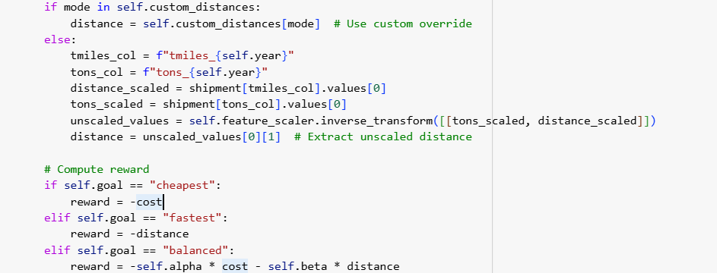
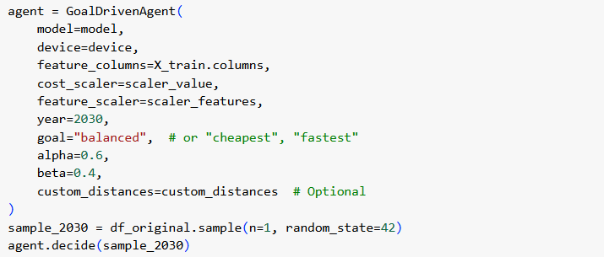
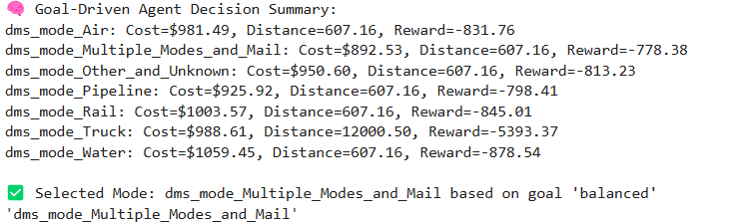
The Decision Layer – Goal Driven AI Agent
If the goal is to have the cheapest mode of transport
If the goal is to choose the transport with the shortest distance
Balance between cost and distance

Slide 7
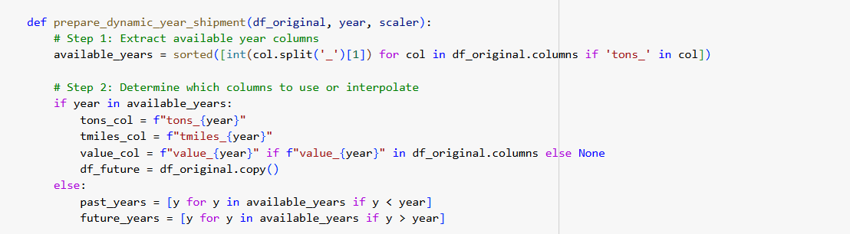
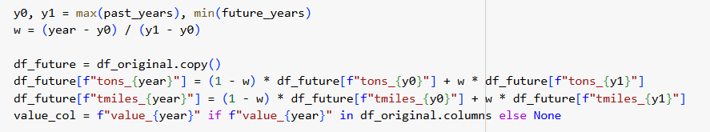
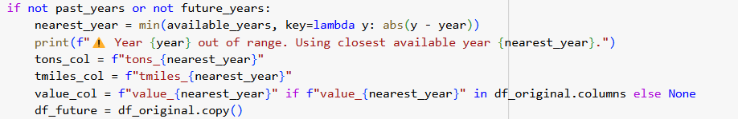
The Forecaster – Teaching AI to See the Future

Slide 8
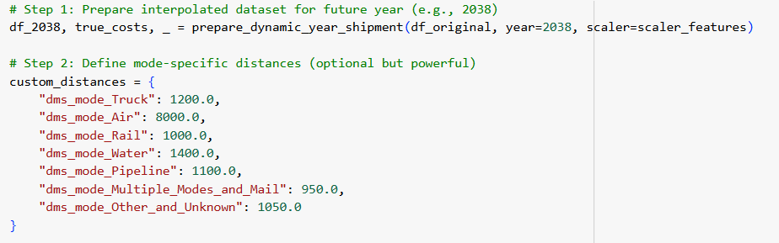
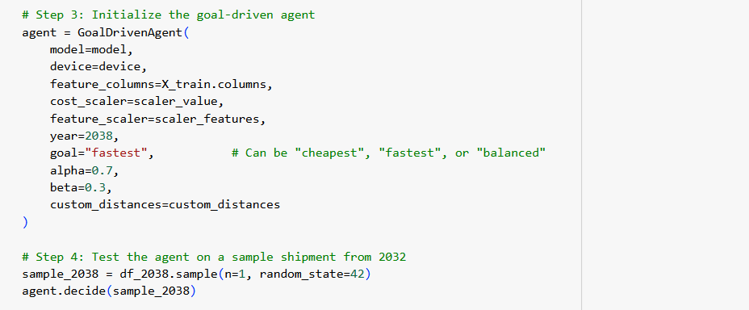
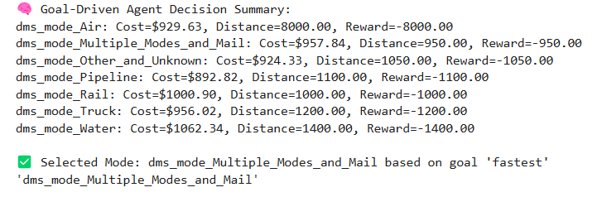
The Forecaster – Teaching AI to See the Future

Slide 9
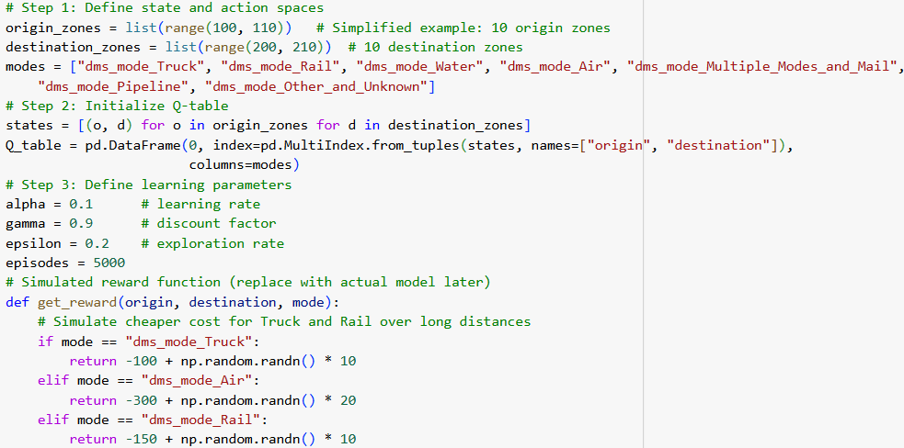
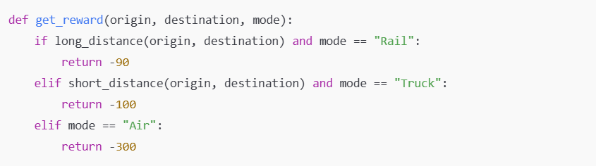
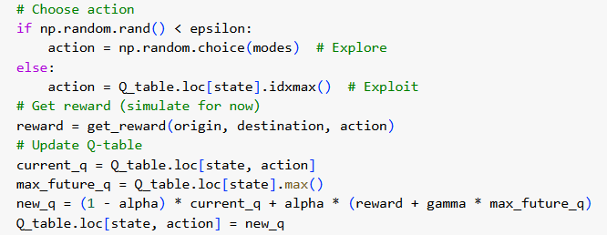
The Self-Improving Agent – A Glimpse into Reinforcement Learning
origin | destination | dms_mode_Truck | dms_mode_Rail | dms_mode_Water
100 | 200 | -103.1170603 | -109.8339776 | -128.8959864
100 | 201 | -102.9981404 | -103.8861457 | -113.6318349
100 | 202 | -110.3146764 | -115.366682 | -113.9308788
100 | 203 | -131.1509505 | -143.945593 | -130.5330391
100 | 204 | -99.40162523 | -101.0310139 | -112.990813
Notes:
This code creates a learning agent that decides the best mode of transportation (like truck, rail, air) for moving goods between zones. It learns by simulating thousands of shipments and adjusting its decisions based on the rewards it gets.

Slide 10
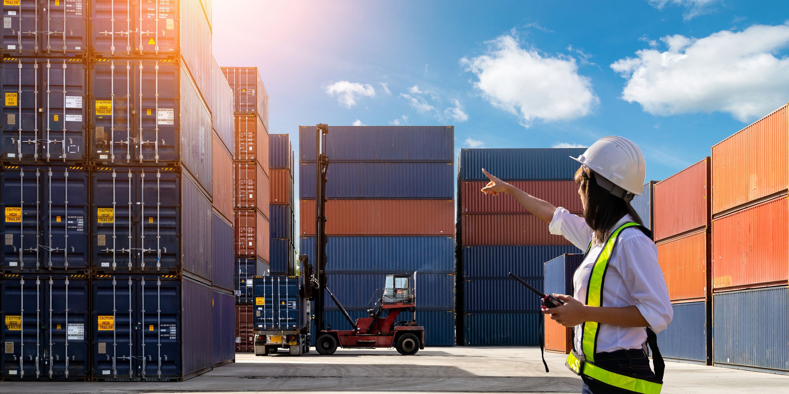
Thank
You

